Slide 1

Corporate Governance Implications of Non-and Deferred Prosecution Agreements
-
Evidence from 1993-2013
Wulf A. Kaal
AALS Midyear Meeting
Washington DC
June 9, 2014

Slide 2
Outline
NDPA Background
Effect on Corporate Practice
  Case Studies
  Empirical Evidence 1993-2013
Effect on the Financial Industry
Effect on Competition and Collaboration in International Financial Markets

Slide 3
NDPA Background
Corporate Wrongdoing
Preemptive Remedial Measures - address corporate wrongdoing and corresponding governance shortcomings themselves or self-report to the DOJ to avoid prosecution
Wrongdoing persists or is not (sufficiently) addressed
Corporation enters into NDPA with the government
Term: typically 3 – 5 years
Government sanctions, fines, restitution, and institutional and governance changes, additional reporting duties
Adherence to avoid criminal indictment
In exchange for the sanctions specified in N/DPAs, the government agrees not to prosecute in the case of NPAs or to dismiss filed charged in the case of DPAs.

Slide 4
NDPA Proliferation

Slide 5
NDPA Proliferation – Factors
1990s: DOJ expands application of NDPAs incrementally
2013: SEC starts issuing DPAs against individuals and corporations - Antitrust Division of DOJ enters into its first DPA
Incentives for Government:
  Prosecutors and corporations have strong incentives to enter into NDPAs and avoid a trial
  Prosecutors use NDPAs to avoid an expensive trial against a sophisticated and well-funded corporate defendant
  NDPAs help prosecutors to impose and enforce monetary penalties, create compliance reform, and force the corporation to fund its own internal investigation
Incentives for Corporations:
  NDPAs allow corporations to avoid the collateral consequences often linked to federal indictment, avoid costly litigation, and mitigate risk.
  N/DPAs allow corporations to institute new policies and satisfy the demands of prosecutors while addressing concerns about the culpability of their executives.

Slide 6
Legitimacy Debate
Prosecutors can promote an ethical corporate culture through enhanced compliance measures in N/DPAs
DOJ’s expansionary tendencies in N/DPAs are a mere extension of compliance (Baer)
“independent private sector oversight” may help address the increased complexity of corporate crime and dwindling public funds
Prosecutors may be uniquely qualified to institute corporate governance changes
Prosecutors’ experience, education, and ability to fill a void left by the system
Form of Dynamic regulation based on institution specific, decentralized, and highly relevant information
Notes:
prosecutors can promote an ethical corporate culture through enhanced compliance measures in N/DPAs and the DOJ’s expansionary tendencies in N/DPAs are a mere extension of compliance McConnell et. al., supra note 28, at 584–86 (touting the benefits of an enhanced compliance program. “Companies with reputations for ethical business practices and good corporate governance tend to have higher stock prices and more satisfied employees. In these and many other regards, a company's decision to act legally and ethically can serve as a catalyst for success.”).

Slide 7
Legitimacy Debate
Rakoff: NDPAs and the DOJ’s focus on corporate prosecutions are morally and technically suspect
NDPAs overly burdensome
Arlen and Kahan: DOJ lacks mandate and governance expertise
Baer / Krawiec: Corps adopt unproven compliance programs - inefficiencies
Epstein / Garret / Paulsen: unequal bargaining power - prosecutorial abuse –coercion
Effect of NDPAs on competitiveness of US capital markets

Slide 8
Changing Corporate America
Coffee (2005): By 2005 DPAs “intruded deeply into corporate governance”
Companies subject to NDPAs are among the largest domestically and worldwide
Financial Institutions subject to NDPAs:
  JPMorgan Chase, Deutsche Bank, ABN Amro Bank, Barclays Bank, Credit Suisse, Fannie Mae, Freddie Mac, General Reinsurance, Lloyds TSB, Metropolitan Life Insurance, UBS, and Wells Fargo
  Collective market capitalization exceeding $690 billion - over $20 trillion AUM
Transformative for Corporate Culture globally - Overall improvements in accountability for corporate wrongdoing – sea change in corporate compliance efforts
Escaping indictment does not mean an escape from accountability
Notes:
John C. Coffee, Jr., Deferred Prosecution: Has It Gone Too Far?, Nat'l L.J., July 25, 2005, at 13

Slide 9
Changing Corporate Practice:
KPMG DPA
August 2005
Wrongdoing: "participated in a scheme to defraud the IRS by devising, marketing, and implementing fraudulent tax shelters . . . .” KPMG tax partners engaged in conduct that was unlawful and fraudulent, including preparing fraudulent tax returns, drafting fraudulent factual tax recitations, issuing false and fraudulent opinions, actively taking steps to conceal true facts from the IRS, and impeding the IRS by failing to produce relevant documents.
Terms:
  Payments of $ 456 million: disgorgement of $ 128 million in fees, restitution to the IRS of $ 228 million, and an IRS penalty of $ 100 million.
  Cooperation and Waiver of Privilege: attorney-client and the work product
  Permanent Restrictions of and Elevated Standards for KPMG's Tax Practice Cooperation.
  New Compliance Program: “permanent compliance office and a permanent educational and training program”
  Independent Monitor: "KPMG agrees to oversight and monitoring by a government appointed monitor.”
  KPMG contradiction of Statement of Facts is breach of NDPA
More than a dozen former KPMG partners have been indicted. Several filed motions to dismiss the indictments against them, or, alternatively, to void portions of the KPMG DPA
Notes:
One brief argued that KMPG's Agreement with the government was for the purpose of intimidating and influencing the firm and those working for it.
A brief by another defendant asserts that "by obligating KPMG and its agents to testify favorably, and only favorably, for the Government, the [67] Department of Justice has irreparably distorted the fact-finding process and ensured that the prosecution of this matter will result in a mock trial.”

Slide 10
Changing Corporate Practice:
MetLife Insurance NPA
April 15, 2010,
Wrongdoing: 1999 through 2005, of making payments, including “contingent commissions,” to brokerages that sold the company’s insurance policies to various employers. (A contingent commission ties a nominally independent broker’s compensation to the total volume of business delivered to the underwriter, and thus arguably creates a conflict between the broker’s fiduciary obligation to secure the best price for his client and his own financial self-interest.)
Terms: IN addition to restitution payments and fine of $13.5 million:
  DOJ sole discretion to determine NPA breach - “not subject to review in any court or tribunal outside the Department”
  Waiver of statute-of-limitations and other defenses if DOJ brings future proceedings
  Cooperation: 2 years with the DOJ and four other federal agencies including submission of “all relevant information, documents, records or other tangible evidence” about which federal investigators inquired
  Cooperation “best efforts” to secure the attendance and cooperation of any officer or employee at any interview or proceeding requested by prosecutors
  No payment of contingent brokerage commissions absent prior written notice of approval from policyholders
  Training programs for employees interacting with brokers
  Complementary auditing and compliance actions.
Notes:
The NPA was, in essence, a follow-on agreement to that which had been reached between the company and New York attorney general Eliot Spitzer on December 29, 2006,[44] for essentially the same conduct by MetLife, with federal jurisdiction premised on the Employee Retirement Security Act.

Slide 11
Changing Corporate Practices:
Johnson & Johnson DPA
On April 8, 2011, J&J ineligible for reimbursement under Medicare or Medicaid if criminal conviction
Wrongdoing: Corporate subsidiaries bribes and kickbacks paid to foreign officials, in violation of the FCPA. Kickbacks had been paid to Saddam Hussein’s Iraqi government under the United Nations Oil-for-Food Program.
Terms:
  $70 million total fines
  Cooperation – 3 years
  Compliance program – six semiannual reports on remediation efforts to date [and] its proposals reasonably designed to improve the internal controls, policies, and procedures of J&J for ensuring compliance with the FCPA and other applicable anticorruption laws.”
  Create CCO position reporting directly to the board of directors
  Appoint heads of compliance for each business segment and a global leadership team for compliance
  Periodic training for and annual certification by “all directors, officers, employees, and, where appropriate, agents and business partners”
  Periodic risk assessments of markets susceptible to corruption and conduct regular audits in operating companies in markets identified as risky, with audits to include on-site visits, the creation of action plans, and review of the books and records of distributors
  Due-diligence reviews of “sales intermediaries, including agents, consultants, representatives, distributors, and joint venture partners”;[58]
  Write “[s]tandard provisions in agreements, contracts, and renewals thereof with all agents and business partners that are reasonably calculated to prevent violations of the anticorruption laws,” including “rights to conduct audits of the books and records of the agent or business partner to ensure compliance”

Slide 12
Empirical Evidence
Timeframe: 1993-2013
Database: 257 public NDPAs
  85.6% contained corporate governance changes
  39.3% BoD changes
Coded 215 governance clusters and sub-clusters
8 General Categories of Mandated Governance Changes:
  Preemptive Remedial Measures
  Business Changes
  Board Changes
  Senior Management
  Monitoring
  Cooperation
  Compliance Program
  Waiver of Rights

Slide 13
Changing Corporate Practice
Empirical Evidence 1993-2013

Slide 15
Accepts Responsibility
“Accepts Responsibility” was coded for all agreements that had a provision in the N/DPA that made reference to the entity accepting responsibility for past wrongful acts
Corporation accepts the results of the investigation and corresponding factual statements of the DOJ
Typical examples include:
  Acceptance of Responsibility: A-B Vol-ve admits, accepts, and acknowledges that it is responsible for the acts of its officers, employees, agents and its wholly-owned subsidiaries, Renault Trucks and VCE, as set forth in the Statement of Facts attached to the Agreement as Appendix A.
  Acceptance of Responsibility: ABN accepts and acknowledges responsibility for its conduct and that of its employees as set forth in the Factual Statement attached hereto as Exhibit A and incorporated herein by reference

Slide 16
Preemptive Remedial Measures
The coded category of preemptive remedial measures describes a variety of measures corporations institute to avoid corporate criminal indictment and / or the execution of an N/DPA.
Coded when the agreement mentioned remedial measures as measure taken before the agreement.
Compliance: Coded when the compliance was instituted before the agreement.
  Code of Conduct that sets forth expectations for ethical conduct by company employees in their business activities, (2) instituted product development processes intended to strengthen compliance controls; (3) developed and implemented, in December 2008, a Compliance Plan which created an independent review process for the approval of consultancies;
  Pride International undertook, of its own accord, remedial measures, including the enhancement of its FCP A compliance program, and agreed to maintain and enhance, as appropriate, its FCP A compliance program as contemplated by this Agreement.
Cooperating: Coded when the cooperation was acknowledged before the agreement.
  Lazard prepared and provided the United States Attorney and Massachusetts Attorney General with extensive computer and financial analyses of business records and financial data pertinent to the Investigation.
  NeuroMetrix cooperated with the USAO in its investigation, which cooperation included making employees available for interviews and testimony without subpoena; responding promptly to requests for documents by producing hundreds of thousands of pages of documents to the USAO, without subpoena and often within a week to ten days of the request; and conducting and providing certain analyses on company computer databases for data requested by the government;
Disclosure: Coded when the information was provided to the Government.
  E&Y has provided to this Office a formal review and assessment of its ethics and compliance program.
  (b) Fiat promptly and thoroughly reported all of its findings to the Department

Slide 17
Preemptive Remedial Measures (cont.)
Firing Employees: Coded when there was a firing or letting go of personnel.
  DS&S has engaged in extensive remediation, including terminating the officers and employees responsible for the corrupt payments;
  (a) terminating or obtaining the resignation of FalconStor officers and employees who were responsible and criminally culpable for the conspiracy to travel in aid of commercial bribery and to violate the securities laws, as set forth in the Complaint;
Internal review: Coded when there was an internal investigation
  c. In consideration of the action of Flowserve in voluntarily conducting an investigation by outside legal counsel regarding the matters described in the attached Statement of Facts
  As a further Remedial Action, and pursuant to the SEC Settlement, HealthSouth retained a qualified consultant ("Governance Consultant") to perform a review of the adequacy and effectiveness of HealthSouth's corporate governance systems, policies, plans, and practices.
Monitoring: Coded when the company already increased its monitoring.
  (a) In May 2009, CVS/pharmacy increased its monitoring of PSE sales by reducing the threshold amount of PSE products that can be ordered by the CVS/pharmacy stores,
  E& Y also has improved internal mechanisms designed to ensure that any concerns about business practices can be raised to appropriate levels.
  MoneyGram has implemented a risk-based Agent audit program that takes into account an Agent's location and number of Consumer Fraud Reports.
New Management: Coded when new management was instituted before the N/DPA.
  ACADEMI LLC replaced all of its executive leadership, including its CEO, coo, and General Counsel
  (c) appointing new management, including, but not limited to, an Interim Chief Executive Officer, a new Chief Operating and Chief Financial Officer, a new Head of Worldwide Sales, and a new GC.

Slide 18
Preemptive Remedial Measures (cont.)
Personnel creation: Coded when a new position was created – before the N/DPA
  AIPC added a General Counsel, a Chief Compliance Officer, and a Director of Internal Audit.
  General Re Corporation has significantly enhanced the review and reporting roles of its Internal Audit Group by implementing the following reforms: (1) appointing a Global Head of lnternal Audit
  (i) creating the position of Ethics and Compliance Officer,
Reporting: Coded when the company reported information to government officials before the N/DPA.
  DS&S initiated an internal investigation and provided real-time reports and updates of its investigation into the conduct described in the Information and Statement of Facts;
  J&J reported all of its findings to the Department
  Smith & Nephew reported its findings to the Department and the SEC;
Training:
  In response to the events described above, CVS/pharmacy has implemented a program of enhanced training and compliance regarding PSE sales.
  The Company has also represented that it has developed additional policies and standard operating procedures regarding employee and distributor compliance training programs.
  As a further Remedial Action, and as provided in the SEC Settlement, HealthSouth is providing reasonable training and education to certain of its officers and employees to minimize the possibility of future violations of federal laws.
New Board
  (a) amending its bylaws to require that, within 30 days of the election of a new board of directors, a special transitional meeting be held to discuss significant issues affecting PARKWAY VILLAGE and to ensure a smooth transition between boards of directors

Slide 22
NDPA Governance Changes

Slide 23
Business Changes
“KPMG will cease its private client tax practice by February 28, 2006, and will take on no new clients or engagements in its private client tax practice after the signing of this Agreement”
“establish a centralized, analytics-based approach to credit, and develop a more accurate account-aging strategy.”
“ACS agrees to refrain from doing any new projects with the Alabama Department of Post-Secondary Education, and any of its subordinate institutions, including serving as a sub-contractor on or receiving income or business indirectly from any new project for that department or its subordinate institutions, for a period of two (2) years from the date of this agreement.”
“Alpha will construct and launch a new state-of-the-art safety training facility in the Julian, West Virginia area. This facility will include a mine lab of approximately 96,000 square feet in which simulated mine situations and conditions will be presented to certified supervisors and examiners to solve and correct”

Slide 24
Business Changes

Slide 26
Board Changes
Reporting: senior official had new reporting duties to the board.
  “ABB will assign responsibility to one or more senior corporate executives of ABB for the implementation and oversight of compliance with policies, standards, and procedures regarding the anti-corruption laws. Such corporate official(s) shall have direct reporting obligations to independent monitoring bodies, such as the Audit Committee of ABB's Board of Directors, and shall have an adequate level of autonomy from management as well as sufficient resources and authority to maintain such autonomy.”
Committees: committee was created.
  The establishment of a Compliance Committee of Aibel Group's Board of Directors, as well as of the Boards of Directors of its parent, Aibel Limited, and its Principal Subsidiaries, and their successors. Such Compliance Committee shall consist of no less than three members and at all times a majority of the members may not be affiliated with the lead shareholders, one of whom shall chair the Committee.
Monitoring: directors assumed additional monitoring duties.
  The Company agrees to enhance, support, and maintain its existing training and education programs, including any programs recommended by the Monitor pursuant to paragraph 18, above. The programs, which shall be reviewed and approved by the Company President and CEO, Board of Directors, Senior Vice President and General Counsel and the Monitor, shall be designed to advance and underscore the Company’s commitment to exemplary corporate citizenship, to best practices of effective corporate governance
Management: management at the highest level was affected.
  The creation of an Office of the Chairman, which includes two new Co-Chief Operating Officers whose responsibilities include supervision of all business areas and departments of NYRA;
Independent Director: independent director(s) were required to be added to the board.
  CA agrees to add new independent directors to its Board of Directors and to undertake corporate governance reforms such that, by December 31, 2005, CA will have:

Slide 29
Senior Management - Senior Management was coded when senior management was tasked with additional work or oversight responsibilities.
For example: “ABB will assign responsibility to one or more senior corporate executives of ABB for the implementation and oversight of compliance with policies, standards, and procedures regarding the anti-corruption laws.”

Slide 31
Monitoring
Monitoring: Coded when the company was required to monitor something.
Examples:
  NETeller agrees to monitor regularly the effectiveness of its procedures and controls designed to prevent its services from being used to conduct U.S. Gambling Transactions, and NETeller will revise and update its procedures and controls as necessary to achieve that purpose.
  Noble shall review its anti-corruption compliance standards and procedures,
  including internal controls, ethics, and compliance programs, no less than annually, and update them as appropriate, taking into account relevant developments in the field and evolving international and industry standards, and update and adapt them as necessary to ensure their continued effectiveness.

Slide 33
Cooperation
Access to facilities
  providing reasonable access to Micrus' documents relating to the Subject Matters, and to all directors, officers, employees, agents, salespeople, attorneys and affiliates, whether or not located in the United States, and to Micrus' facilities for that purpose;
  This obligation of truthful disclosure includes an obligation to provide to the Fraud Section access to MONSANTO COMPANY’s facilities, documents, and employees
Best efforts testimony
  Bixby shall use its best efforts to make available for interviews or testimony, as requested by the government, present or former directors, officers, employees, agents and consultants of Bixby as well as the directors, officers, employees, agents and consultants of contractors and subcontractors.
  (d) shall, at SDNY's or DANY's' request, use its best efforts promptly to secure the attendance and truthful statements or testimony of any officer, agent or employee at any meeting or interview or before the grand jury or at any trial or other court proceeding;

Slide 34
Cooperation
Disclose activities
  (a) shall truthfully and completely disclose all information with respect to the activities of Essie, its officers and employees, and others concerning all matters relating to
  (b) truthfully and completely disclose information with respect to the activities of FARO, its officers and employees, and others concerning all matters about which this Office inquires of it, which information can be used for any purpose, except as otherwise limited in this Agreement;
Documents
  identifying, assembling, organizing and producing, in a responsive and prompt manner, all non-privileged, non-attorney work-product documents, information, and other materials (including but not limited to providing reports or analyses of data concerning Respondent's models, credit risk reporting or data systems) to the Commission as requested by the Division's staff, wherever located, in the possession, custody, or control of the Respondent;
  This obligation of truthful disclosure includes the obligation of Fiat, Iveco, CNH Italia, and CNH France to provide to the Department, upon request, any document, record, or other tangible evidence relating to such corrupt payments, books and records, and internal controls about which the Department inquires of Fiat, Iveco, CNH Italia, and CNH France.

Slide 35
Cooperation
Knowledgeable Employees
  Upon request of the Department, with respect to any issue relevant to its investigation of HealthSouth, HealthSouth shall designate knowledgeable employees, agents or attorneys to provide information and/or materials on HealthSouth's behalf to the Department.
  Upon request of the United States, with respect to any issue relevant to its investigation of fraud involving aircraft parts, MacKenzie shall designate knowledgeable employees, agents or attorneys to provide to the United States the information and materials described in Paragraph 5
Identify witnesses:
  Cooperation under this paragraph shall include identification of witnesses who, to Reliant's knowledge, may have material information regarding the matters under investigation and/or prosecution
  Cooperation under this paragraph shall include identification of witnesses who, to the knowledge of SCHIAVONE, may have material information regarding the Unlawful Conduct, or records which may have material information regarding the Unlawful Conduct;
Authenticity:
  (f) Providing testimony, certifications, and other information deemed necessary by the Office or a court to identify or establish the original location, authenticity, or other evidentiary foundation necessary to admit into evidence documents in any criminal or other proceeding as requested by the Office.
  Providing testimony, certifications, and other non-privileged information deemed necessary by the Office or a court to identify or establish the original location, authenticity, or other evidentiary foundation necessary to admit into evidence documents in any criminal or other proceeding relating to compliance with health care laws as requested by the Office;

Slide 36
Cooperation
Logistical Support
  (b) shall cooperate fully with this Office and the United States Department of Agriculture (the "USDA"); (c) shall, at the Office's request, use its best efforts to assist the Office in any prosecution or investigation arising out of the Covered Conduct by providing logistical, technical, accounting, and any other support requested for any meeting, interview, grand jury proceeding, or any trial or other court proceeding;
  assist the Division in any investigation or prosecution arising out of the conduct described in paragraph 5(a), whether by former employees of the Company or any other individual or entity, by providing logistical and technical support for any meeting, interview, grand jury proceeding, or any trial or other court proceeding;
Criminal Activity
  (c) proactively disclosing to the Office all information concerning any criminal wrongdoing or suspected criminal wrongdoing beyond that specifically addressed in the attached Information, which has not yet been explicitly disclosed to the Office, and which is either currently in Bovis's possession or which may come into its possession in the future, including conduct of the type alleged in the Information;
  (c) bring to the Government's attention all potentially criminal conduct by LPS or any of its employees that relates to violations of U.S. laws (i) concerning fraud or (ii) concerning mortgage or foreclosure document execution services;

Slide 40
Compliance Program
Reporting: company was required to report something.
  Abt Associates agrees that it will notify the Government Administrative Contracting Officer (ACO), presently at US AID, the Director of Procurement for USAID, and the US AID Lead Contact Specialist in writing within 20 calendar days of the discovery of any billing error or adjustment in excess of $100 identified as the result of any management, internal auditing, or third-party audit/CPA review.
  NETeller will retain the Monitor to provide to this Office reports assessing NETeller' s compliance with the NETeller Controls Report (the "Compliance Reports"); (ii) the first of the Compliance Reports will be provided to this Office on or about December 4, 2007, and subsequent reports will be provided at such other time on or before December 4, 2008, as designated by this Office;
Corporate Compliance Policy: “clearly articulated and visible corporate policy” was required.
  DS&S will develop and promulgate a clearly articulated and visible corporate policy against violations of the FCPA and other applicable foreign law counterparts (collectively, the "anti-corruption laws,"), which policy shall be memorialized in a written compliance code.
Compliance Code: compliance code was required.
  Promulgation of a compliance code, standards, and procedures designed to reduce the prospect of violations of the FCPA, other applicable anti-corruption laws, and Ingersoll's compliance code.

Slide 41
Compliance Program
Due Diligence: Coded when due diligence was required.
  To the extent that the use of agents and business partners is permitted at all by Lufthansa Technik, it will institute appropriate due diligence and compliance requirements pertaining to the retention and oversight of all agents and business partners by it and its subsidiaries, including:
Enforcement: Coded when the company needed an enforcement mechanism.
  ABB will institute appropriate disciplinary procedures to address, among other things, violations of the anti-corruption laws and ABB's compliance and ethics program by ABB's directors, officers, and employees.
Financial and Books: Coded when the below statement was required:
  A system of financial and accounting procedures, including a system of internal accounting controls, designed to ensure the maintenance of fair and accurate books, records and accounts.
Guidance: Coded when the company had to establish an effective system for providing guidance to employees.
  9. The Company will maintain, or where necessary establish, an effective system for providing guidance and advice to directors, officers, employees, and, where necessary and appropriate, agents and business partners, on complying with the Company’s anti-corruption compliance code, policies, and procedures, including when they need advice on an urgent basis or in any foreign jurisdiction in which the Company operates.

Slide 42
Compliance Program
Compliance policies and procedures: Coded when the company had to promulgate compliance standards and procedures.
  Promulgation of compliance standards and procedures designed to reduce the prospect of violations of the traceability and food laws and HONEY HOLDING's compliance code and appropriate measures to encourage and support the observance of ethics and compliance standards and procedures against traceability violations at all levels of the company.
Hotline: Coded when a hotline was created.
  (d) The establishment and maintenance of an employee hotline, managed through an outside service, and communication to all IFCO employees of the existence of the hotline and the ability to inform IFCO's Compliance Officer of any suspected violation of law, including the hiring and employment of persons unauthorized to work in the United States;
CCO: Coded when a Chief Compliance Officer position was created.
  Appoint a senior corporate executive with significant experience with compliance with the FCPA, including its anti-bribery, books and records, and internal controls provisions, as well as other applicable anticorruption laws and regulations (hereinafter “anticorruption laws and regulations”) to serve as Chief Compliance Officer. The Chief Compliance Officer will have reporting obligations directly to the Audit Committee of the Board of Directors.
Code of ethics: Coded when a code of ethics was implemented.
  10. The Company shall adhere to the AdvaMed Code of Ethics on Interactions with Health Care Professionals. The AdvaMed Code can be found at www.advamed.org. The principles set forth in the AdvaMed Code are expressly incorporated as compliance requirements
  18. The Government acknowledges that FSG and Subsidiaries have drafted a Code of Business Ethics and Conduct, attached hereto as Exhibit C.

Slide 45
Waiver of Rights
Waive AC: Coded when the company waived attorney-client privilege
  Not asserting a claim of attorney-client or work-product privilege as to any documents, information, or testimony requested by the Department or the SEC related to factual internal investigations or contemporaneous advice given to AIG-FP concerning the subject matters. In making production of any such documents, AIG-FP neither expressly nor implicitly waives its right to assert any privilege that is available under Jaw against entities
Limited privilege waiver: Coded when a limited privilege waiver was requested.
  (c) if requested by the USAOs, negotiate in good faith to attempt to arrive at a limited waiver of the attorney-client privilege and work­ product doctrine sufficient to allow the USAOs to be provided with identified materials otherwise withheld under a claim of these protections;
Not waiving AC: Coded when the company did not waive Attorney-Client Privilege.
  Nothing in this Agreement shall be construed as a waiver by Alpha or Massey of the attorney-client privilege, the attorney work-product doctrine, or any other applicable privilege or protection with respect to documents or records requested by the Government.
6th: Coded when the company waived its rights to a speedy trial.
  By entry into this Agreement, ACADEMI LLC and its former affiliates expressly waive all rights to a speedy trial pursuant to the Sixth Amendment of the United States Constitution,

Slide 46
Waiver of Rights
SoL: Coded when waived the right to bring a challenge regarding statute of limitations or when the statute of limitations was tolled.
  Adams Thermal further knowingly waives any claim to assert that the prosecution is time barred under the statute of limitations or any other provision.
  The Respondent agrees that the running of any statute of limitations applicable to any action or proceeding against it authorized, instituted, or brought by or on behalf of the Commission arising out of the Investigation (an “Enforcement Action”), including any sanctions or relief that may be imposed therein, is tolled and suspended during the Deferred Period.
Admissibility: Coded when waived the right to challenge admissibility of information.
  If the United States, pursuant to Paragraph 10 of this Agreement, initiates a prosecution that is deferred by this Agreement against ABN, ABN agrees that it will neither contest the admissibility of the Factual Statement, reports, or any other documents provided by ABN to the United States or the government of the Netherlands, nor contradict in any such proceeding the facts contained within the Factual Statement.
  It is understood that if it is determined that Adelphia has committed any crime after signing this Agreement or has given false, incomplete, or misleading testimony or information, or has otherwise violated any provision of this Agreement, (a) all statements made by Adelphia to this Office, the SEC, or other designated law enforcement agents, and any testimony given by any then current officer, agent or employee of Adelphia before a grand jury or other tribunal, whether prior to or subsequent to the signing of this Agreement, and any leads from such statements or testimony shall be admissible in evidence in any criminal proceeding brought against Adelphia; and (b) Adelphia shall assert no claim under the United States Constitution, any statute, Rule ll (e)(6) of the Federal Rules of Criminal Procedure, Rule 410 of the Federal Rules of Evidence, or any other federal rule that such statements or any leads therefrom should be suppressed.

Slide 47
Waiver of Rights
Indictment: Coded when waived right to indictment
  Waiver of Rights: Novo knowingly waives its right to indictment on the charges described in Paragraph 2 and contained in the Information
Disclosure: Coded when the company “consents to any and all disclosures”
  With respect to any information, testimony, document, record or other tangible evidence provided to the Department of Justice pursuant to this Agreement, AOL consents to any and all disclosures to the SEC and law enforcement entities of such materials as the Department of Justice, in its sole reasonable discretion, deems appropriate in furtherance of its criminal investigation of any individuals related to the subject matters.
Venue: Coded when waiving venue.
  Further, Friedman’s agrees that such proceeding may be commenced in the Eastern District of New York and Friedman’s hereby waives any right to challenge the venue in the Eastern District of New York.

Slide 52
NDPA Effect on Financial Industry

Slide 53
NDPA Effect on Financial Industry

Slide 54
NDPA Effect on Financial Industry

Slide 55
NDPA Effect on Financial Industry

Slide 56
NDPA Effect on Financial Industry

Slide 57
NDPA Effect on Competition and Collaboration in International Financial Markets
Responding to the crisis, authorities proposed a diverse array of regulatory reforms.
Role of NDPAs in the reform efforts?
Adding to existing regulatory burden?
Effect on Competitiveness of US Capital Markets?
Barriers to Entry?
Issue for dual listings?

Slide 59
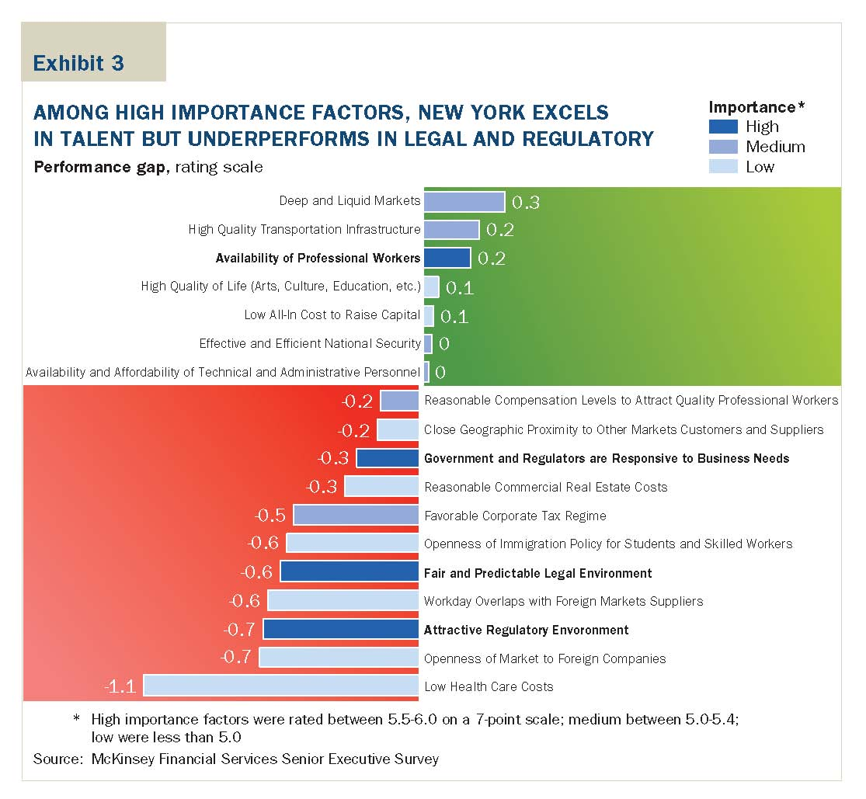
Notes:
(Bloomberg-Schumer, McKinsey: 2006)
Green is a NY plus, so availability of talent (dark blue on green) was a high plus factor for New York based on a survey of issuers and thought New York had a 20% advantage, performance gap. Red is London plus, so London had major advantage on Responsiveness, Legal and Regulatory Environment. FSF survey confirms, next slide
79

Slide 60
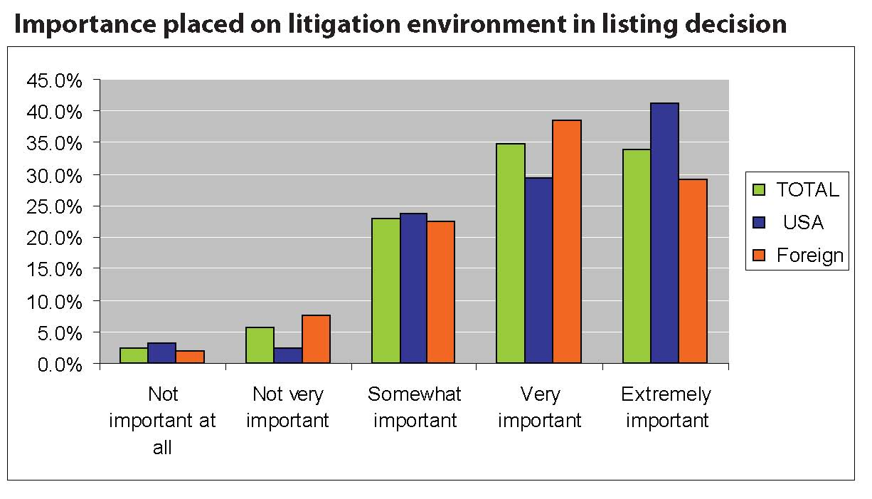
Source: Financial Services Forum, 2007 Global Capital Markets Survey
Notes:
Securities class actions the major legal/regulatory issue
80

Slide 61
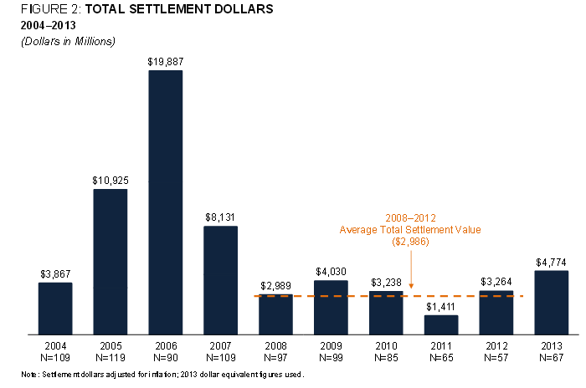
Notes:
Filing have been going up again
81

Slide 62
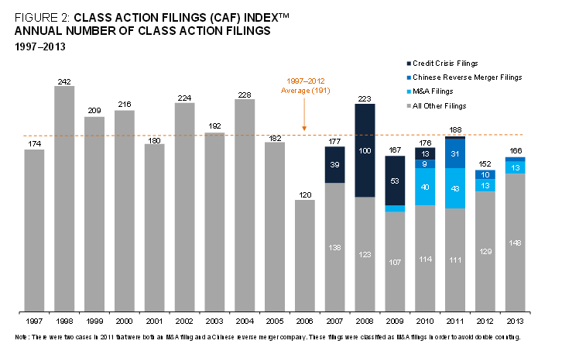

Slide 63
NDPA Effect on Competition and Collaboration in International Financial Markets
NDPAs as Dynamic Regulation
Institution specific, decentralized, and high quality information ex-ante not ex-post
Feedback Effects: Corp. vs. Regulator
  Wrongdoing – Regulatory investigation
  Preemptive/Remedial Efforts – Regulatory evaluation
  Self-reporting – Regulatory evaluation
  Continuing Wrongdoing – Corporate criminal indictment
  Negotiation of NDPA - Execution of NDPA
Intra NDPA Feedback Effects:
  Cooperation – Monitoring – Reporting
Notes:
Preferable to “pure” predictive regulation without feedback effect
Graph Feedback effects of NDPAs
Also illustrate that the feedback effect shifts from an equal bargaining position to a one sided bargaining power (DOJ) after remedial efforts and self reporting fialed and when an NDPA has been executed
Explain how NDPAs can also have an effect on individuals directly rather than only the corporation – KPMG
Intra NDPA Feedback Effects: Cooperation – Monitoring – Reporting

Slide 64
NDPA Effect on Competition and Collaboration in International Financial Markets
Effect on Competitiveness of US Capital Markets?
  Unlike congressional mandates – NDPA feedback effect
  Unlike securities class action settlements – NDPA feedback effect
Market entrants only have to confront NDPAs upon:
  Wrongdoing
  Remedial efforts failed
  Weak negotiation position for NDPA

Slide 65
Thank You

